Slide 1
MILESTONE-4
Data Visualization Patterns
Cybersecurity Attack Analysis — Predictive & Executive Power BI Dashboards
TEAM 1
Chandra Harshitha
Abhilash Reddy
Sartak Raj
Tasleem Banu Y M

Slide 2
Agenda
What we'll walk through today
01
02
Project Overview
Security Risk Assessment
Objectives, scope, and the dataset behind the analysis
Global attack footprint, severity mix, and top threat types
03
04
Predictive Threat Analytics
Executive Command Centre
AI-forecasted risk and 60-day trend projection
Real-time operations view for leadership decision-making
05
06
Forecasting, Alerting & Performance
Key Takeaways & Next Steps
Alert triage, response metrics, and system health
Consolidated insights and recommended actions
Milestone-4 · Data Visualization Patterns
2

Slide 3
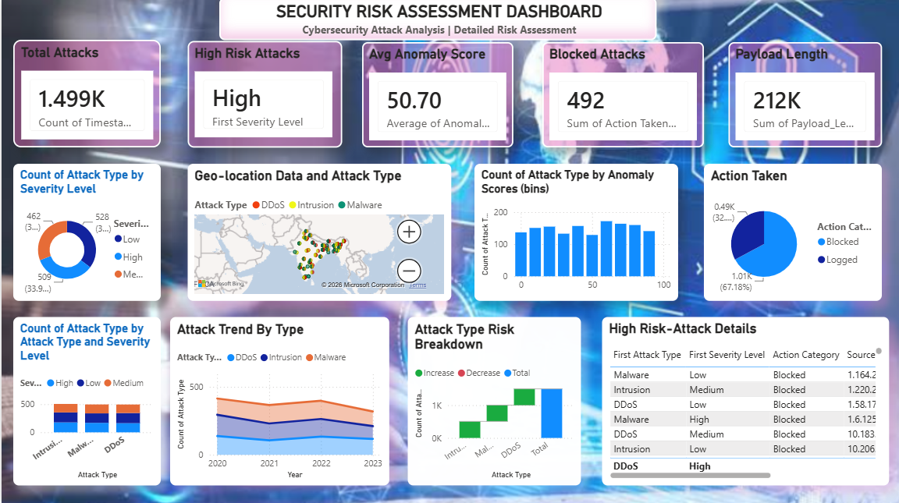
DASHBOARD 1
Security Risk Assessment Dashboard
Detailed risk assessment view
KEY POINTS
1,499 total attacks with High as the top severity level and an average anomaly score of 50.70.
492 attacks blocked and payload length totaling 212K across all recorded traffic.
Geo-location map plots DDoS, Intrusion and Malware events, concentrated across South Asia.
High-risk attack details table lists DDoS, Malware and Intrusion cases with action taken and source.
Milestone-4 · Data Visualization Patterns
3

Slide 4
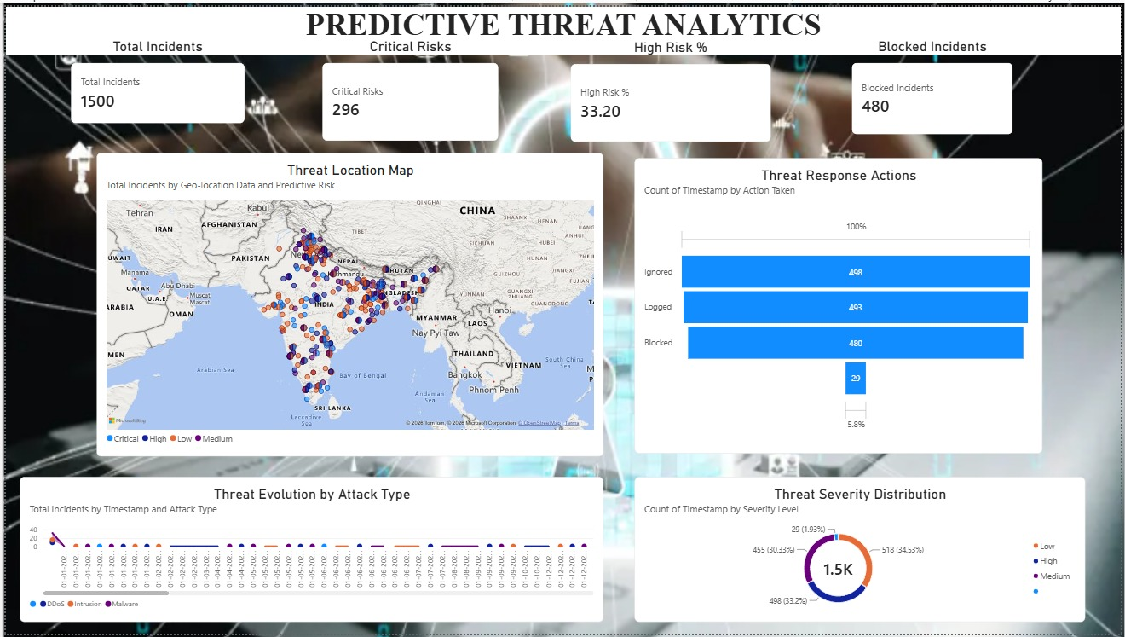
DASHBOARD 2
Predictive Threat Analytics
Geo-based predictive risk view
KEY POINTS
1,500 total incidents with 296 critical risks and a high-risk rate of 33.20%.
480 incidents blocked, tracked alongside a threat-response funnel of Ignored (498), Logged (493) and Blocked (480).
Threat location map plots Critical, High, Low and Medium incidents densely across India and neighboring regions.
Severity donut shows 1.5K total incidents split 34.5% Low, 33.2% Medium and 30.3% High.
Milestone-4 · Data Visualization Patterns
4

Slide 5
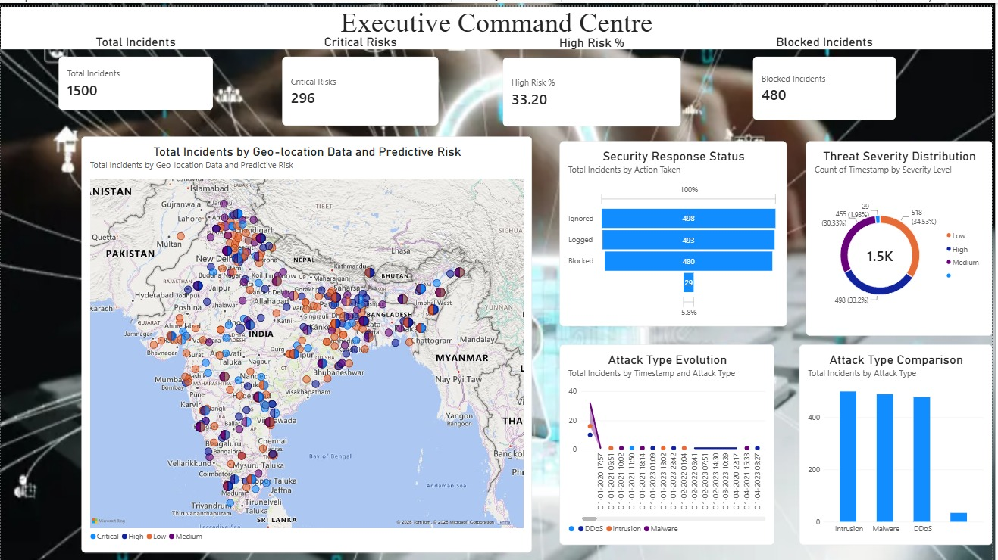
DASHBOARD 3
Executive Command Centre
Geo-based executive overview
KEY POINTS
Mirrors the Predictive Threat Analytics KPIs — 1,500 incidents, 296 critical, 33.20% high risk, 480 blocked.
Security response status funnel again shows Ignored (498) leading Logged (493) and Blocked (480).
Attack-type evolution timeline plots DDoS, Intrusion and Malware events across the incident timestamps.
Attack-type comparison bars rank Intrusion, Malware and DDoS as the leading incident categories.
Milestone-4 · Data Visualization Patterns
5

Slide 6
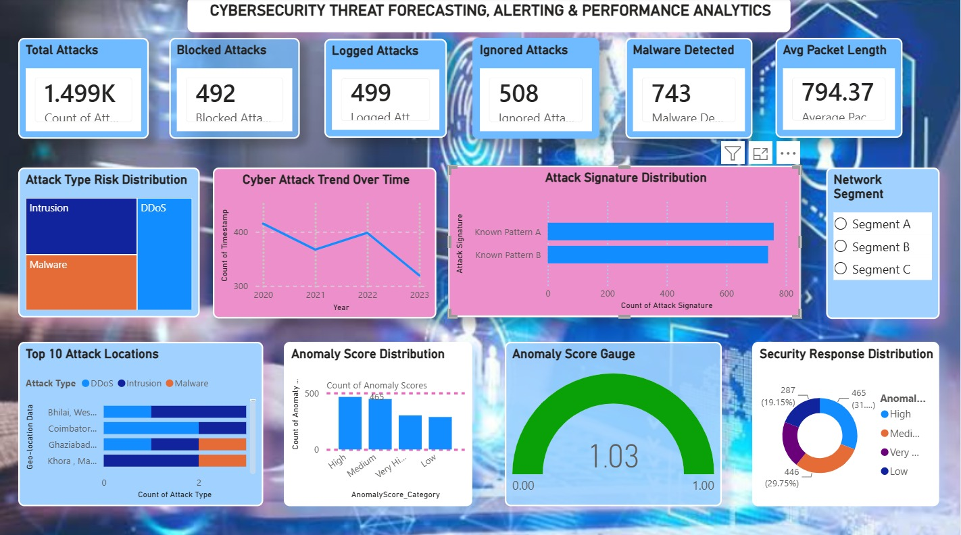
DASHBOARD 4
Cybersecurity Threat Forecasting, Alerting & Performance Analytics
Network and signature-level detail
KEY POINTS
1,499 total attacks with 492 blocked, 499 logged and 508 ignored, plus 743 malware detections.
Average packet length of 794.37 and an anomaly score gauge reading 1.03 quantify traffic behavior.
Attack signature distribution compares Known Pattern A and B counts, both exceeding 700 occurrences.
Top 10 attack locations and a security response donut (High 31%, Low 29.75%) round out the operational view.
Milestone-4 · Data Visualization Patterns
6

Slide 7
CONCLUSION
Final Outcome & Next Steps
All four dashboards draw on the same ~1,500-attack dataset and consistently show High severity/risk near 33%, with response actions splitting roughly evenly across Blocked, Logged and Ignored. Geo-mapped views concentrate incidents across South Asia, while the forecasting-and-signature dashboard adds packet-level and anomaly-score detail — together giving both a strategic and an operational lens on the same underlying threats.
01
02
03
04
Unify the KPIs
Sharpen geo-targeting
Close the loop on 'Ignored'
Extend forecasting
Standardize on one set of headline metrics (total, blocked, high-risk %) across every dashboard view.
Use the geo-location maps to prioritize monitoring and response resourcing for the highest-density regions.
Investigate why Ignored actions rival Blocked and Logged, and route more of them into active response.
Build on the anomaly-score and packet-length signals to predict emerging attack signatures earlier.
TEAM 1
Chandra Harshitha · Abhilash Reddy · Sartak Raj · Tasleem Banu Y M

